Slide 1
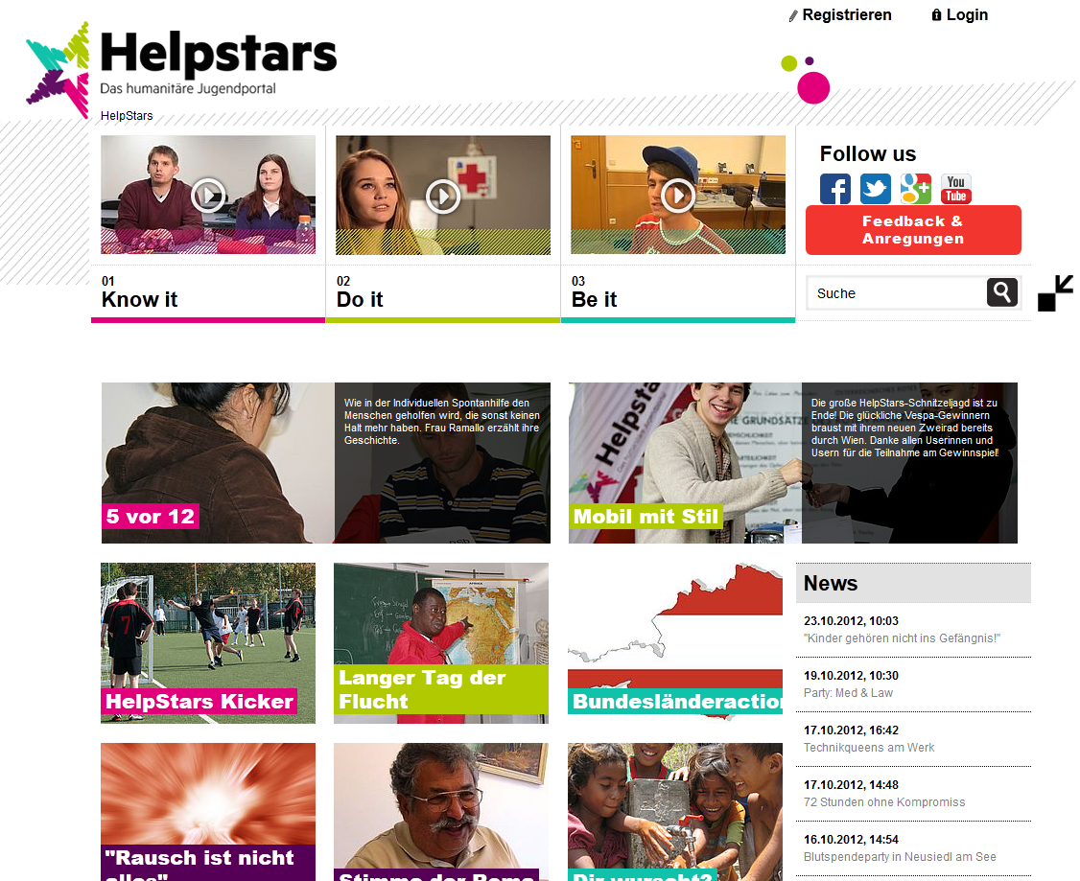

Slide 2
The Basics
Sender: Austrian Red Cross and Austrian Youth Red Cross together with the provincial branches
Target group: Youth (ages 13+)
Realisation: Super-fi
Channels to the webpage: Facebook, Twitter, Google+, YouTube,…

Slide 3
Our mission
Helpstars is a webpage that provides information about topics of everyday life, both in, and outside the classroom. Users are provided with direct help, as well as low-threshold mentoring.
We want to inspire young people toward humanitarianism. There is no bias of religion, political or ideological background.
Young people are consumers on the one hand and providers of content on the other hand.

Slide 4
structure
three-step layout | networking | videos

Slide 5
„content is king!“
three parts with different levels of engagement: „know it“, „do it“, „be it“ (read, comment, post content)
content paraphrased for the target group
social-media-elements for networking
images and video are to be the essential part of the platform – interactivity
relevant appointments and services from all over the country

Slide 6
feedback…
„Helpstars is colourful, but clearly arranged and it seems young and stylish.“
„I have a positive impression. Austrian Red Cross wants to reach young people and gives them information about the organisation.“
„In my opinion Helpstars is colourful and bright. Operator is the Austrian Red Cross.“
„The Youth Red Cross wants to inspire young people for volunteer work.“
„Finally something useful for the youth work!“
„The colourful look meets the taste of young people.“
„The Red Cross wants to bring people together with this new webpage“.

Slide 7
How to succeed
External Communications
Online-Marketing
Red Cross-publications (on and offline)
Cooperations (content, events, community-activism…)
Testimonial (Julian Le Play – a young Austrian artist)

Slide 8
contact
redaktion@helpstars.at
Online: www.helpstars.at
Facebook: www.facebook.com/helpstars
Google Plus: https://plus.google.com/ (HelpStars)
Twitter: https://twitter.com/helpstars_at

